Slide 1

JavaScript, Sixth Edition
Chapter 4
Debugging and Error Handling
JavaScript, Sixth Edition

Slide 2
Objectives
When you complete this chapter, you will be able to:
Recognize error types
Trace errors with dialog boxes and the console
Use comments to locate bugs
Trace errors with debugging tools
Write code to respond to exceptions and errors
JavaScript, Sixth Edition

Slide 3
Introduction to Debugging
Programming languages have syntax (rules)
Logic
  Order in which various program parts run (execute)
Bug
  Any program error
    Causes program to function incorrectly due to incorrect syntax or flaws in logic
Debugging
  Process of tracing and resolving errors in a program
JavaScript, Sixth Edition

Slide 4
Understanding Syntax Errors
Syntax errors
  Occur when interpreter fails to recognize code
  Causes
    Incorrect use of JavaScript code
    References to non-existent objects, methods, variables
JavaScript, Sixth Edition

Slide 5
Handling Run-Time Errors
Run-time errors
  Occur when interpreter encounters a problem while program executing
    Not necessarily JavaScript language errors
  Occur when interpreter encounters code it cannot execute
  Run-time error can be caused by a syntax error
JavaScript, Sixth Edition

Slide 6
Identifying Logic Errors
Logic errors
  Flaw in a program’s design
    Prevents program from running as anticipated
  “Logic” reference
    Execution of program statements and procedures in the correct order to produce the desired results
  Example: multiplying instead of dividing
    var divisionResult = 10 * 2;
    document.write("Ten divided by two is equal to "↵
    + divisionResult);
JavaScript, Sixth Edition

Slide 7
Identifying Logic Errors (cont’d.)
  Example: infinite loop
    for (var count = 10; count >= 0; count) {
    document.write("We have liftoff in " + count);
    }
  Example: infinite loop corrected
    for (var count = 10; count >= 0; count--) {
    document.write("We have liftoff in " + count);
    }
JavaScript, Sixth Edition

Slide 8
Interpreting Error Messages
First line of defense in locating bugs
  Browser console displays
    Line number where error occurred
    Error description
Run-time errors
  Error messages generated by a web browser
    Can be caused by syntax errors but not by logic errors
  Example:
function missingClosingBrace() {
var message = "This function is missing a closing brace.";
window.alert(message);
JavaScript, Sixth Edition

Slide 9
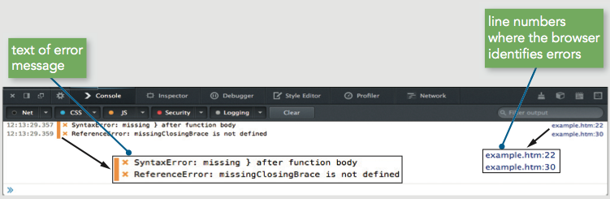
Interpreting Error Messages (cont’d.)
Figure 4-3 Firefox error messages
JavaScript, Sixth Edition

Slide 10
Interpreting Error Messages (cont’d.)
Error message
  Displays error’s general location in a program
    Not an exact indicator
Browsers do not strictly enforce JavaScript syntax
Mitigating bugs in JavaScript programs
  Always use good syntax
  Thoroughly test with every browser type, version
    Test browser if used by more than one percent of the market
JavaScript, Sixth Edition

Slide 11
Using Basic Debugging Techniques
Syntax errors can be difficult to pinpoint
A few common techniques are helpful in tracking down bugs
JavaScript, Sixth Edition

Slide 12
Tracing Errors with the window.alert() Method
Tracing
  Examining statements in an executing program
window.alert() method
  A useful way to trace JavaScript code
  Place at different points within program
    Used to display variable or array contents or value returned from a function
Use multiple window.alert() methods
  Check values as code executes
Example: function not returning correct result of 485
  Returning 5169107
JavaScript, Sixth Edition

Slide 13
Tracing Errors with the window.alert() Method (cont’d.)
function calculatePay() {
var payRate = 15; numHours = 40;
var grossPay = payRate * numHours;
window.alert(grossPay);
var federalTaxes = grossPay * .06794;
var stateTaxes = grossPay * .0476;
var socialSecurity = grossPay * .062;
var medicare = grossPay * .0145;
var netPay = grossPay - federalTaxes;
netPay *= stateTaxes;
netPay *= socialSecurity;
netPay *= medicare;
return netPay;
}
JavaScript, Sixth Edition

Slide 14
Tracing Errors with the window.alert() Method (cont’d.)
Drawback
  Must close each dialog box for code to continue executing
Use selectively at key points
Place debugging code at different indent level to distinguish from program code
JavaScript, Sixth Edition

Slide 15
Tracing Errors with the console.log() Method
Trace a bug by analyzing a list of values
Logging
  writing values directly to the console using the console.log() method
  syntax: console.log(value);
  can log string literal, variable value, or combination
Example
  calculatePay() function
JavaScript, Sixth Edition

Slide 16
Tracing Errors with the console.log() Method (cont’d.)
function calculatePay() {
var payRate = 15; numHours = 40;
var grossPay = payRate * numHours;
console.log("grossPay is " + grossPay);
var federalTaxes = grossPay * .06794;
var stateTaxes = grossPay * .0476;
var socialSecurity = grossPay * .062;
var medicare = grossPay * .0145;
var netPay = grossPay - federalTaxes;
console.log("grossPay minus federalTaxes is " + netPay);
netPay *= stateTaxes;
console.log("netPay minus stateTaxes is " + netPay);
netPay *= socialSecurity;
console.log("netPay minus socialSecurity is " + netPay);
netPay *= medicare;
console.log("netPay minus medicare is " + netPay);
return netPay;
}
calculatePay();
JavaScript, Sixth Edition

Slide 17
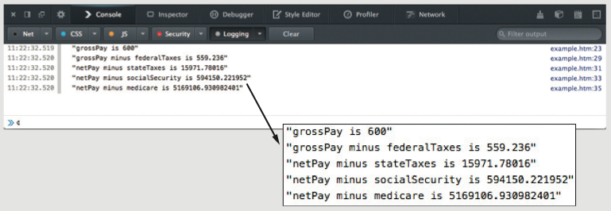
Tracing Errors with the console.log() Method (cont’d.)
Figure 4-11 Contents of the console after executing the calculatePay() function
JavaScript, Sixth Edition

Slide 18
Tracing Errors with the console.log() Method (cont’d.)
Driver program
  simplified, temporary program
  contains only the code you are testing
JavaScript, Sixth Edition

Slide 19
Using Comments to Locate Bugs
Another method of locating bugs
  “Comment out” problematic lines
Helps isolate statement causing the error
When error message first received
  Start by commenting out only the statement specified by the line number in the error message
  Continue commenting lines until error eliminated
JavaScript, Sixth Edition

Slide 20
Combining Debugging Techniques
Combine debugging techniques
  Aid in search for errors
Example:
  Use comments combined with an alert box or log message to trace errors in the calculatePay() function
JavaScript, Sixth Edition

Slide 21
Combining Debugging Techniques (cont’d.)
^{function calculatePay() {}
^{var payRate = 15;}
^{var numHours = 40;}
var grossPay = payRate * numHours;
^{window.alert(grossPay);}
// var federalTaxes = grossPay * .06794;
// var stateTaxes = grossPay * .0476;
// var socialSecurity = grossPay * .062;
// var medicare = grossPay * .0145;
// var netPay = grossPay – federalTaxes;
^{// netPay *= stateTaxes;}
^{// netPay *= socialSecurity;}
^{// netPay *= medicare;}
^{// return Math.round(netPay);}
}
JavaScript, Sixth Edition

Slide 22
Dependencies
Relationship in which one statement depends on another statement executing successfully
Can make debugging more challenging
Important to retest program after fixing a bug to ensure other parts aren't affected by change
JavaScript, Sixth Edition

Slide 23
Tracing Errors with Debugging Tools
Available in current versions of all modern browsers
  Internet Explorer (IE)
  Chrome
  Firefox
Accessible through same panel that opens when you use the console
JavaScript, Sixth Edition

Slide 24
Tracing Errors with Debugging Tools (cont’d.)
Examining code manually
  Usually first step taken with a logic error
  Works fine with smaller programs
Debugging tools
  Help trace each line of code
  More efficient method of finding and resolving logic errors
JavaScript, Sixth Edition

Slide 25
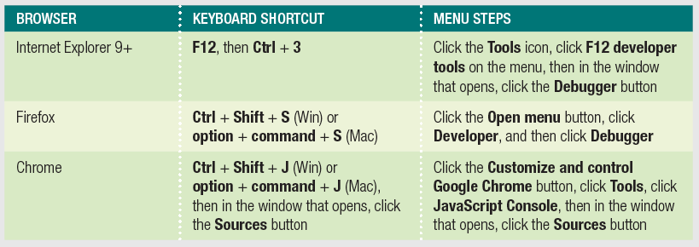
Understanding the IE, Firefox, and Chrome Debugger Windows
Using Debugger Windows
  Open a document to debug in a browser
  Use keyboard shortcut or menu to open debugger
Table 4-1: Steps to open debuggers in IE, Firefox, and Chrome
JavaScript, Sixth Edition

Slide 26
Understanding the IE, Firefox, and Chrome Debugger Windows (cont’d.)
Debugger window
  Usually separate pane attached to bottom of browser window
  Can also detach pane into separate window
JavaScript, Sixth Edition

Slide 27
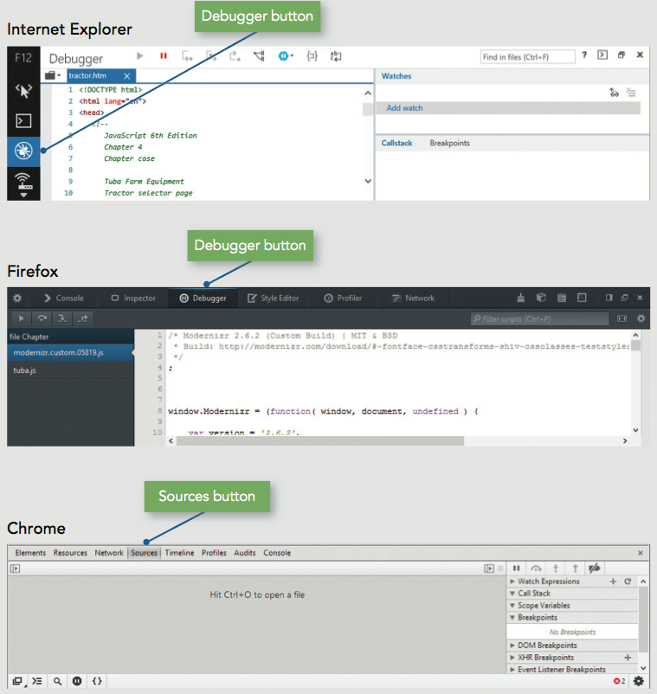
Understanding the IE, Firefox, and Chrome Debugger Windows (cont’d.)
Internet Explorer
  Shows HTML code by default
  Click View sources to select a different file
JavaScript, Sixth Edition

Slide 28
Understanding the IE, Firefox, and Chrome Debugger Windows (cont’d.)
Firefox
  Lists JavaScript files alphabetically
  Click a filename to see its contents
JavaScript, Sixth Edition

Slide 29
Understanding the IE, Firefox, and Chrome Debugger Windows (cont’d.)
Chrome
  Displays no files by default
  press Ctrl + O (Win) or command + O (Mac) to select from list of associated files
JavaScript, Sixth Edition

Slide 30
Setting Breakpoints
Break mode
  Temporary suspension of program execution
  Used to monitor values and trace program execution
Breakpoint
  Statement where execution enters break mode
When program paused at a breakpoint
  Use debug tools to trace program execution
JavaScript, Sixth Edition

Slide 31
Setting Breakpoints (cont’d.)
To set a breakpoint
  Click the line number of the statement where execution should stop
Resume button (Firefox/Chrome), Continue button (IE)
  Executes rest of the program normally or until another breakpoint encountered
JavaScript, Sixth Edition

Slide 32
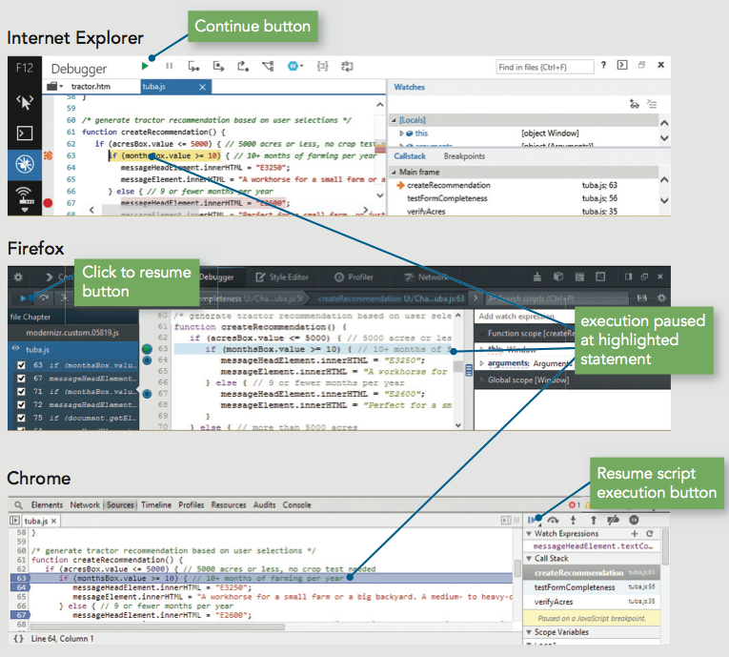
Setting Breakpoints (cont’d.)
Figure 4-20 tuba.js execution stopped at the line 63 breakpoint
JavaScript, Sixth Edition

Slide 33
Clearing Breakpoints
To clear a breakpoint
  Click the line number
To clear all breakpoints
  Right-click any breakpoint
  Click "Remove all breakpoints" or "Delete all"
JavaScript, Sixth Edition

Slide 34
Stepping Through Your Scripts
Stepping into
  Executes an individual line of code
    Pauses until instructed to continue
  Debugger stops at each line within every function
Stepping over
  Allows skipping of function calls
  Program still executes function stepped over
Stepping out
  Executes all remaining code in the current function
  Debugger stops at next statement in the calling function
JavaScript, Sixth Edition

Slide 35
Tracing Variables and Expressions
Variables list
  Displays all local variables within the currently executing function
  Shows how different values in the currently executing function affect program execution
Watch list
  Monitors variables and expressions in break mode
JavaScript, Sixth Edition

Slide 36
Tracing Variables and Expressions (cont’d.)
  To access watch list
    IE
      Displayed by default on right side of pane
      In break mode, local and global variables displayed
    Firefox
      Click Expand Panes button
      Shows watch and variables list on right side of pane
    Chrome
      Displayed by default on right side of pane
JavaScript, Sixth Edition

Slide 37
Tracing Variables and Expressions (cont’d.)
  To add an expression to the watch list
    Locate an instance of the expression in the program
    Select it and copy it to the Clipboard
    Click "Click to add" (IE) or "Add watch expression (Firefox or Chrome)
    Paste expression from Clipboard
    Press Enter
JavaScript, Sixth Edition

Slide 38
Examining the Call Stack
Call stack
  Ordered lists of which procedures (functions, methods, event handlers) have been called but haven't finished executing
Each time a program calls a procedure:
  Procedure added to top of the call stack
JavaScript, Sixth Edition

Slide 39
Examining the Call Stack
IE and Chrome
  Call stack list displayed to right of code
Firefox
  Call stack list displayed above code
JavaScript, Sixth Edition

Slide 40
Handling Exceptions and Errors
Bulletproofing
  Writing code to anticipate and handle potential problems
One bulletproofing technique
  Validate submitted form data
Exception handling
  Allows programs to handle errors as they occur in program execution
Exception
  Error occurring in a program
JavaScript, Sixth Edition

Slide 41
Throwing Exceptions
Execute code containing an exception in a try statement
throw statement
  Specifies an error message in case an error that occurs within a try block
try {
var lastName = document.getElementById("lName").value;
if (lastName === "") {
throw "Please enter your last name.";
}
}
JavaScript, Sixth Edition

Slide 42
Catching Exceptions
Use a catch statement
  Handles, or “catches” the error
Syntax:
  catch(error) {
    statements;
  }
Example:
  catch(lNameError) {
    window.alert(lNameError);
    return false;
  }
JavaScript, Sixth Edition

Slide 43
Executing Final Exception Handling Tasks
finally statement
  Executes regardless of whether its associated try block throws an exception
  Used to perform some type of cleanup
    Or any necessary tasks after code evaluated with a try statement
JavaScript, Sixth Edition

Slide 44
Implementing Custom Error Handling
Primary purpose of exception handling
  Prevent users from seeing errors occurring in programs
  Provide graceful way to handle errors
Reason for using exception handling with JavaScript
  Evaluate user input
Programmers may write their own error-handling code
  Can write user-friendly messages
  Provides greater control over any errors
JavaScript, Sixth Edition

Slide 45
Implementing Custom Error Handling (cont’d.)
Catching errors with the error event
  Executes whenever error occurs on a Web page
  Name of function to handle JavaScript errors
    Assigned as event listener for error event
  Preventing the Web browser from executing its own error handling functionality
    Return return a value of true from the error event handler function
JavaScript, Sixth Edition

Slide 46
Implementing Custom Error Handling (cont’d.)
Writing custom error-handling functions
  JavaScript interpreter automatically passes three arguments to the custom error handling function
    Error message, URL, line number
  Use these values in custom error handling function
    By adding parameters to the function definition
  Use parameters in the function
    Show a user the location of any JavaScript errors that may occur
JavaScript, Sixth Edition

Slide 47
Additional Debugging Techniques
Includes
  Checking HTML elements
  Analyzing logic
  Testing statements with console command line
  Using the debugger statement
  Executing code in strict mode
  Linting
  Reloading a Web page
JavaScript, Sixth Edition

Slide 48
Checking HTML Elements
If a bug cannot be located using methods described in this chapter:
  Perform a line-by-line analysis of the HTML code
  Ensure all necessary opening and closing tags included
Use code editor specialized for web development
  Highlights syntax errors as you type
Use the W3C Markup Validation Service to validate a Web page
JavaScript, Sixth Edition

Slide 49
Analyzing Logic
Some JavaScript code errors stem from logic problems
  Can be difficult to spot using tracing techniques
Analyze each statement on a case-by-case basis
JavaScript, Sixth Edition

Slide 50
Testing Statements with the Console Command Line
Console command line
  Testing and executing JavaScript statements
    Without HTML document or JavaScript source file
  Useful if trying to construct the correct syntax for a mathematical expression
Enter JavaScript statement at command line in web browser’s console
Including multiple statements at the command line
  Separate statements with a semicolon
JavaScript, Sixth Edition

Slide 51
Using the debugger statement
When you include the debugger statement in your code
  web browser stops executing JavaScript code when it reaches the debugger statement
  equivalent of a breakpoint that's part of your JavaScript code
JavaScript, Sixth Edition

Slide 52
Using Strict Mode
Strict mode
  Removes some features from JavaScript
  Requires more stringent syntax for other features
    Example: must always use var to declare variables
Many removed or altered features in strict mode are known to cause hard to find bugs
Include statement "use strict";
  Including at start of script section requests strict mode for all code in that section
  Including at start of code block in function requests strict mode just for that function
JavaScript, Sixth Edition

Slide 53
Linting
Running code through a program that flags some common issues that may affect code quality
jslint is a commonly used linting program
Similar result to using strict mode, but generates a report containing line numbers
JavaScript, Sixth Edition

Slide 54
Reloading a Web Page
Usually click the browser Reload or Refresh button
Web browser cannot always completely clear its memory
  Remnants of an old bug may remain
  Force web page reload
    Hold Shift key and click the browser’s Reload or Refresh button
May need to close browser window completely
May need to delete frequently visited web pages
JavaScript, Sixth Edition

Slide 55
Summary
Three types of program errors
  Syntax errors, run-time errors, logic errors
  Error messages
  First line of defense in locating bugs
Tracing
  Examination of individual statements in an executing program
Using console.log() method to trace bugs
  Helpful to use a driver program
Browser debugging tools
JavaScript, Sixth Edition

Slide 56
Summary (cont’d.)
Break mode
  Temporary suspension of execution to monitor values and trace execution
Breakpoint: statement in the code at which program execution enters break mode
Stepping into, stepping over, and stepping out
Variables list and watch list
Call stack
  List of procedures that have started but not finished
JavaScript, Sixth Edition

Slide 57
Summary (cont’d.)
Bulletproofing
  Writing code to anticipate, handle potential problems
Exception handling
try, throw, catch, finally statements
JavaScript includes an error event
  Executes whenever an error occurs on a web page
Additional debugging methods and techniques
  Checking HTML elements, analyzing logic, console command line, debugger statement, strict mode, linting, and reloading a web page
JavaScript, Sixth Edition

